Slide 1

Bastille - Mantid
Progress July-October 2016

Slide 2
Summary Last PMC meeting
30 June 2016
Mantid team (Verena, Gagik, Antti + Ian) recruited and trained
Work concerning IN16B and IN4/IN5/IN6 started (continuing previous efforts by S. Howells for BS and R. Ferraz-Leal and A. Wilcke for TOF)
Agreement between Mantid & Lamp for simplest cases
September → Presentation of Backscattering & TOF to spectroscopy group – deploy and support software
Notes:
Can say here that working through BS and TOF is an opportunity to reflect on how to run the project most efficiently eg. completeness of initial requirements, scope creep, unforeseen challenges, frequency and nature of meetings, learning to work with Mantid and contributing to the project (code reviewing), generic improvements, etc

Slide 3
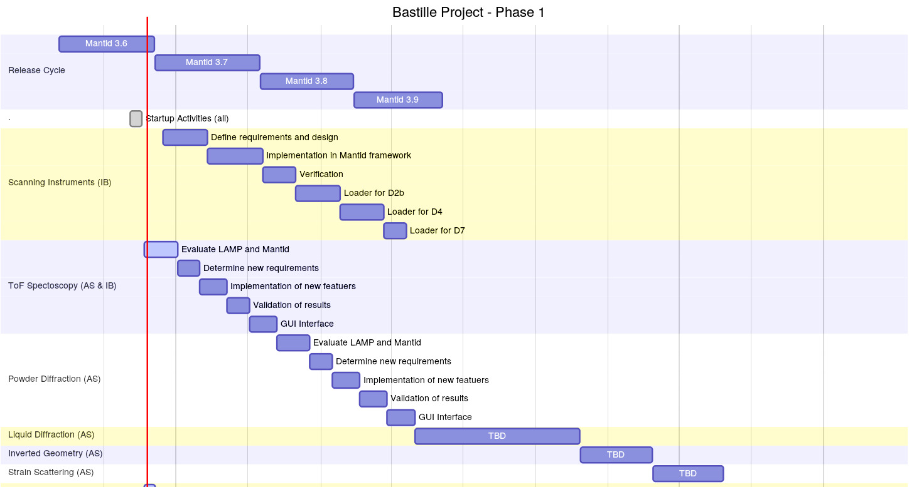
1/10/16
1/1/17
Just started design of new implementation!
Evaluation/comparison ✓
Requirements/workflow ✓
Validation
GUI
Postponed! 2017 – No NeXus yet!
Notes:
Say that this is/was a provisional planning (GANTT chart), to be reviewed based on experience acquired. First work may take longer than anticipated, later work may be quicker due to experience acquired and generic improvements that have been implemented (eg multiple file handling). BUT developed software will also have to be supported ie more support and less development as project progresses…

Slide 4
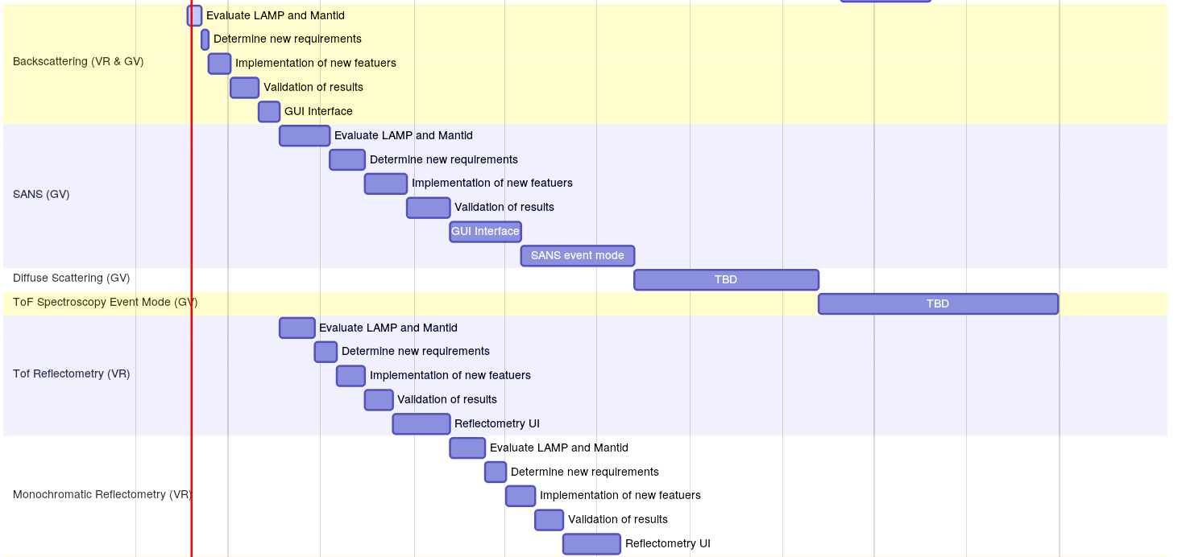
1/10/16
1/1/17
Evaluation/comparison ✓
Requirements/workflow ✓
Validation
GUI (IndirectILLReduction)
Start mid-Nov?
Start mid-Nov?
Notes:
Important point here is to decide on what to do next and how – probably in DS Head of Service meeting.

Slide 5
Working team
Ian Bush, Antti Soininen: TOF
Verena Reimund, Gagik Vardanyan: Backscattering
Weekly meetings:
+ Bjorn Fak, Tilo Seydel,
Eric Pellegrini, Miguel A. Gonzalez

Slide 6
Status TOF (IN4/IN5/IN6)
Data treatment validated → I(2θ,ω), S(Q,ω), G(ω)
Working using scripts - OK
Need to improve (accelerate: py→C++) self-shielding correction algorithms (CylinderPaalmanPingsCorrection, FlatPaalmanPingsCorrection, ApplyPaalmanPingsCorrection)
Still need to decide on user interface (data processor UI developed at ISIS, ~reflectometer)
IN5 – Single Crystal (Vates)
Notes:
I think what you have is more than ‘basic’! GUI: need to decide on this (auto-generated GUI exists!) – probably merge with BS for uniformity at ILL. ISIS and SNS have not standardised in this way. Also mention algorithm runner (reflectometry development) for handling many data sets (like prox sheet in Lamp). Can also emphasise that GUI will offer all options in a standard way, avoiding problem of circulation of incomplete or partial scripts.

Slide 7
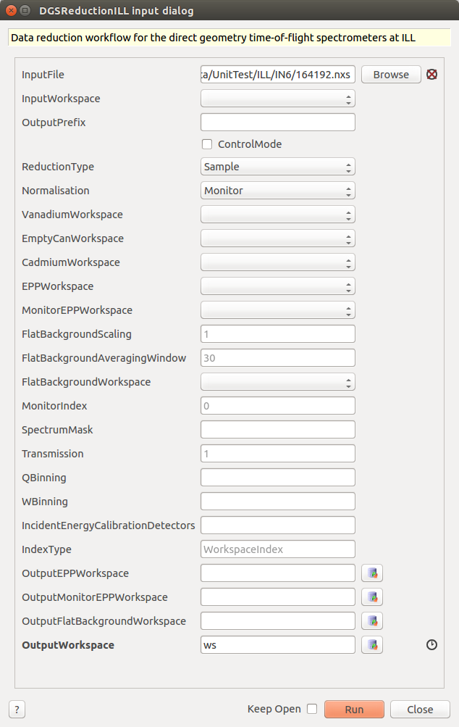
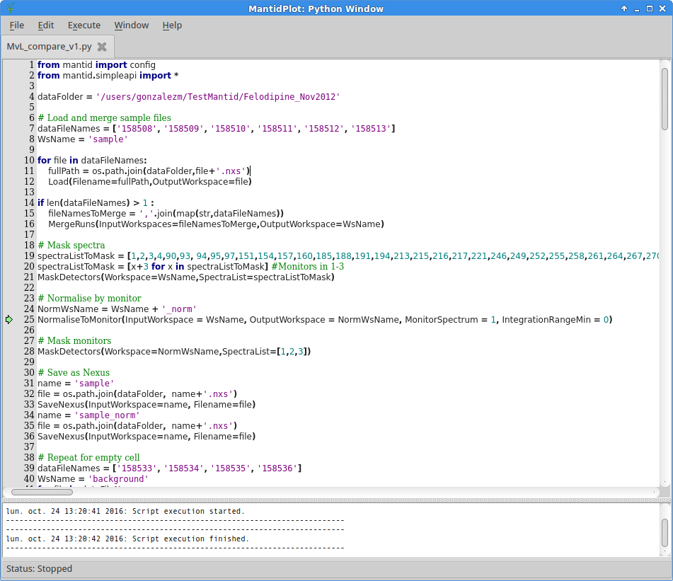
Status TOF (IN4/5/6)

Slide 8
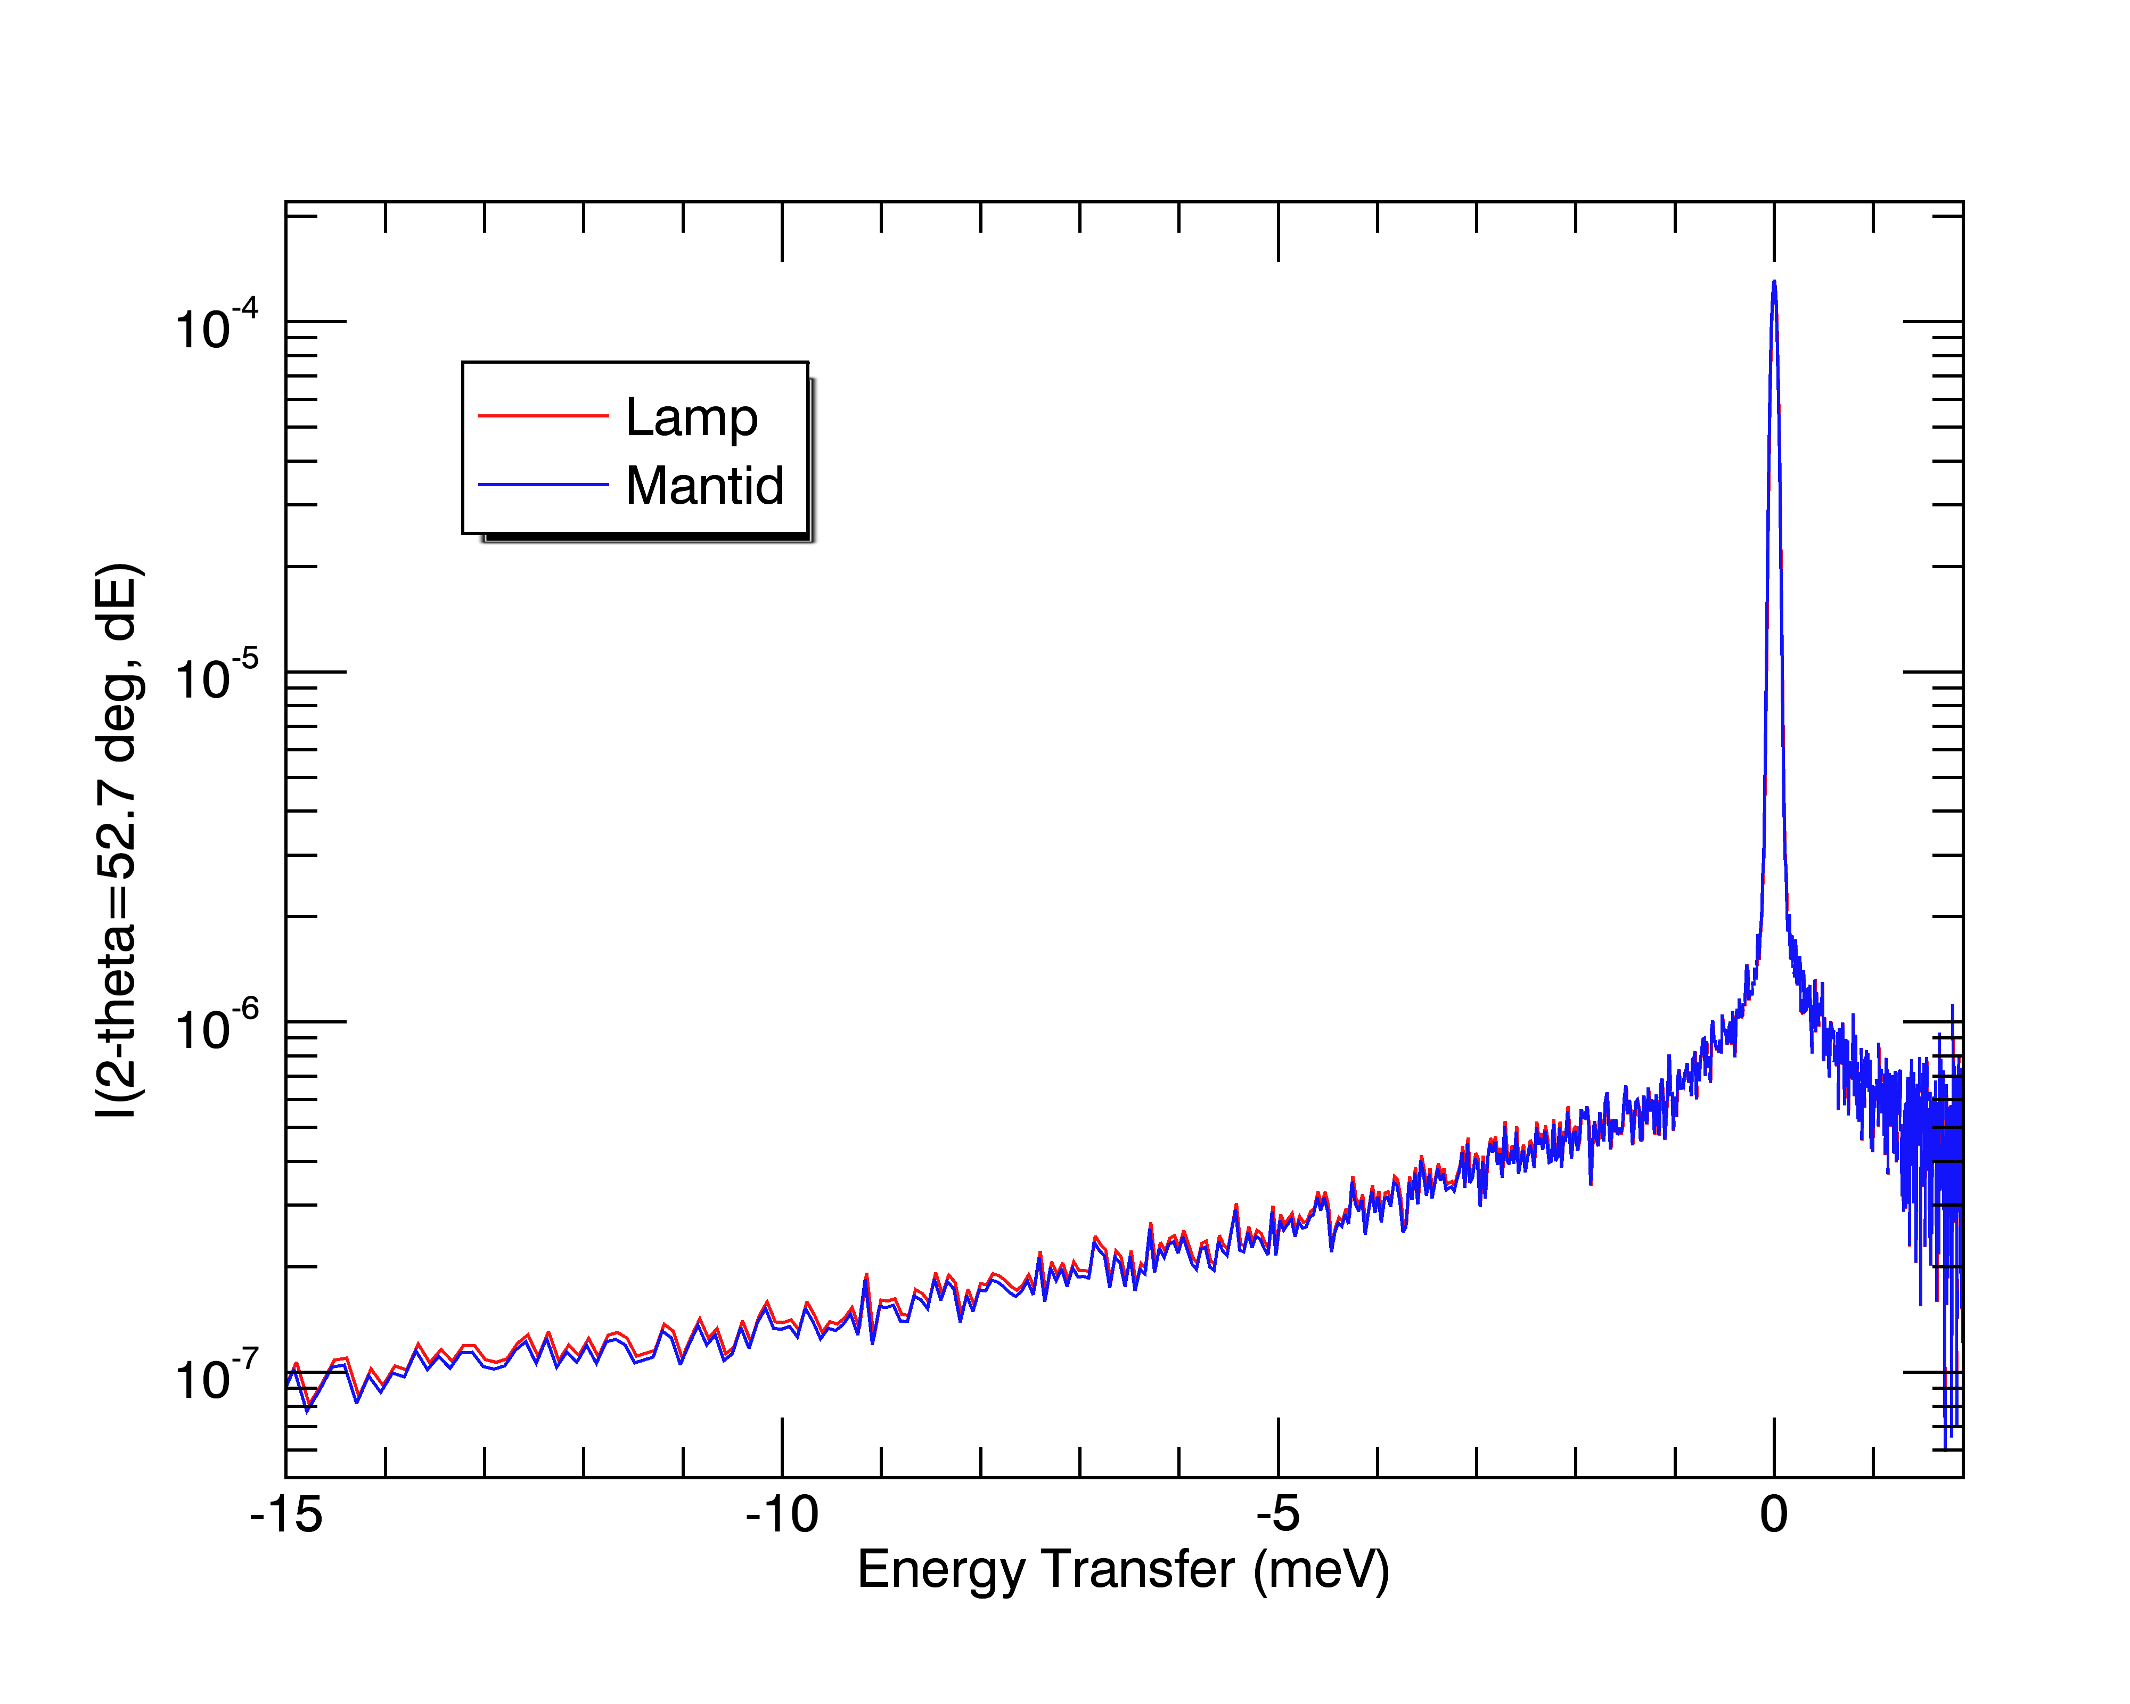
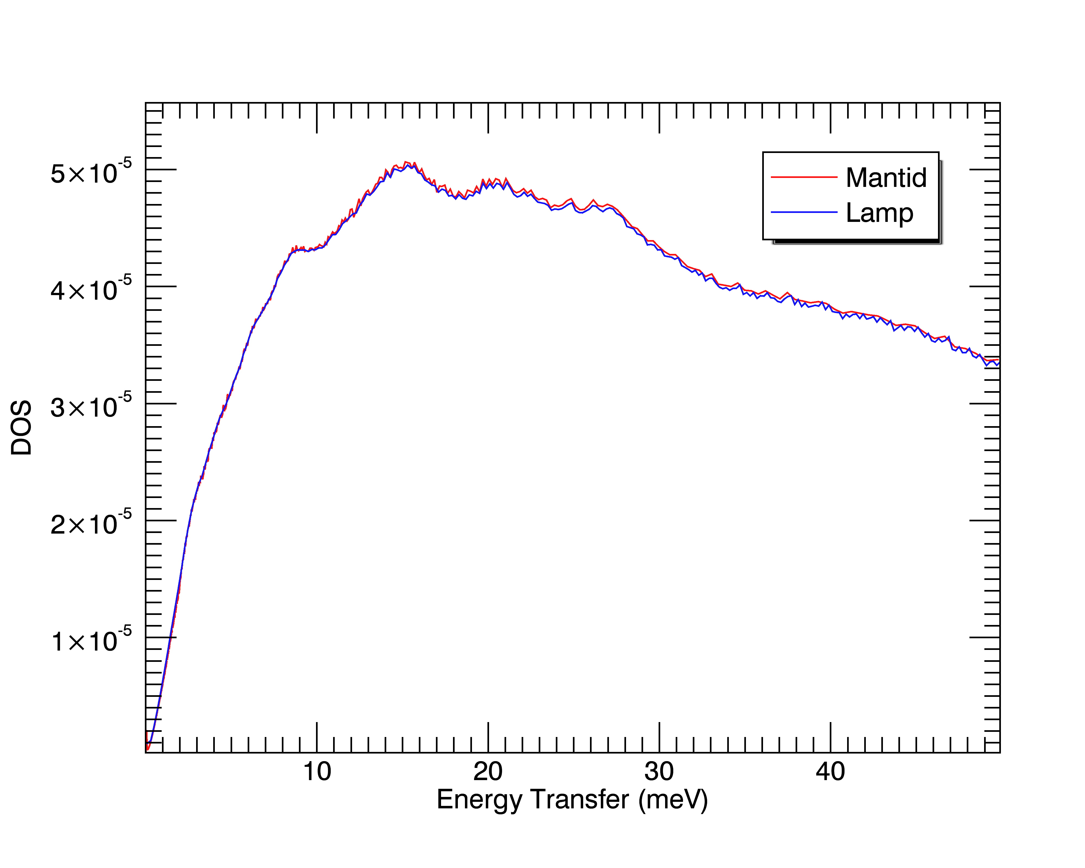
Status TOF (IN4/IN5/IN6)
I(2θ,ω)
G(ω)
DOS: Mantid calculation based on S(Q,ω) vs Lamp based on S(2θ,ω). Coherent vs incoherent?

Slide 9
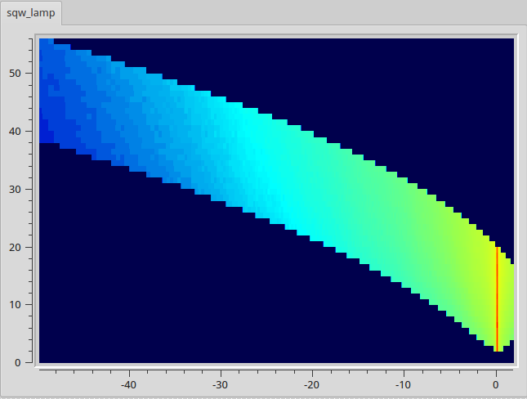

Status TOF (IN4/IN5/IN6)
S(Q,ω)

Slide 10
Status BS (IN16B)
Data treatment validated
QENS and Fixed window scans (elastic & inelastic)
GUI exists (based on adaptation from existing ISIS UI), but converge to similar UI shared by TOF and BS?
Provide possibility to customize integration ranges (vertical PSD tubes, energy channels for FWS)? For PSD it is possible through XML detector group file
IN13 (not immediately – NeXus needed)

Slide 11
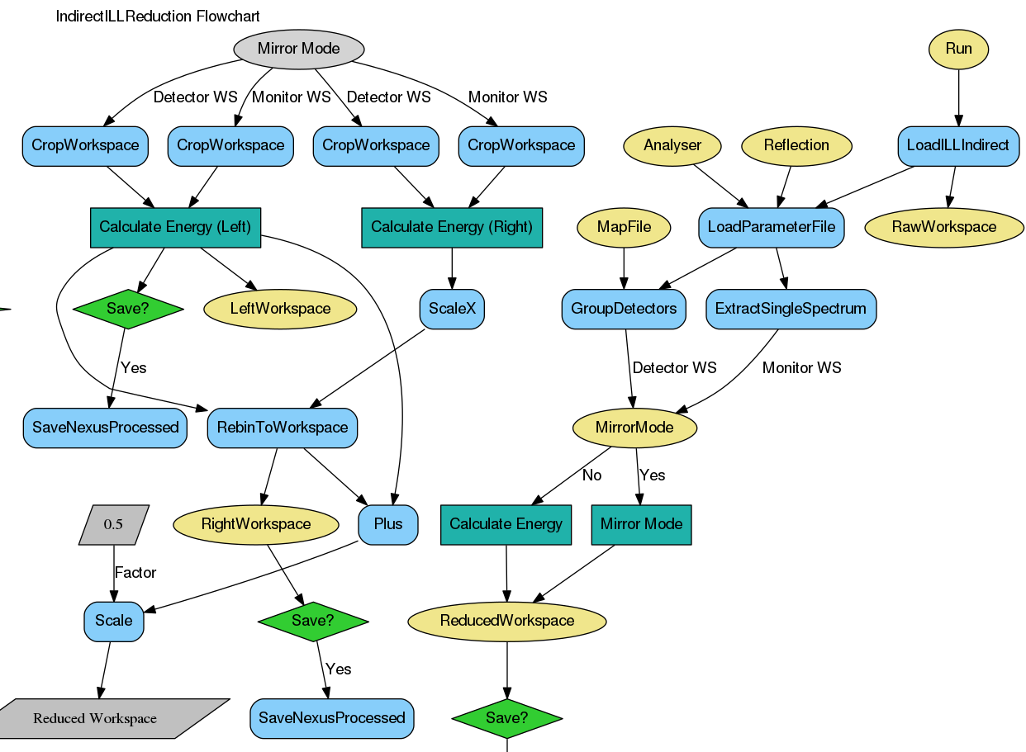
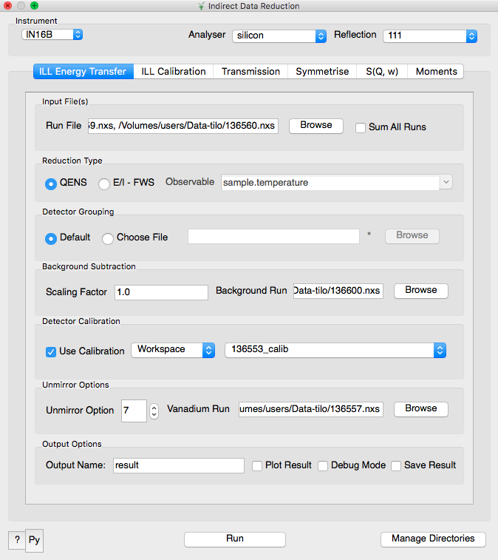
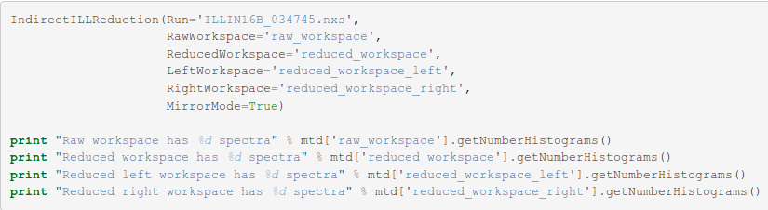
Status BS (IN16B)

Slide 12
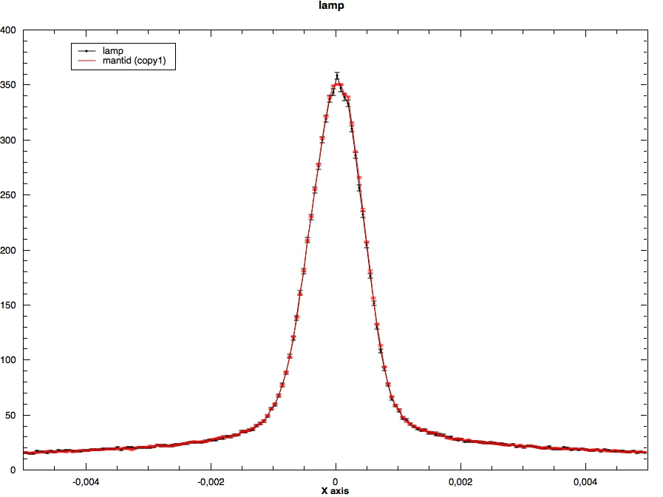
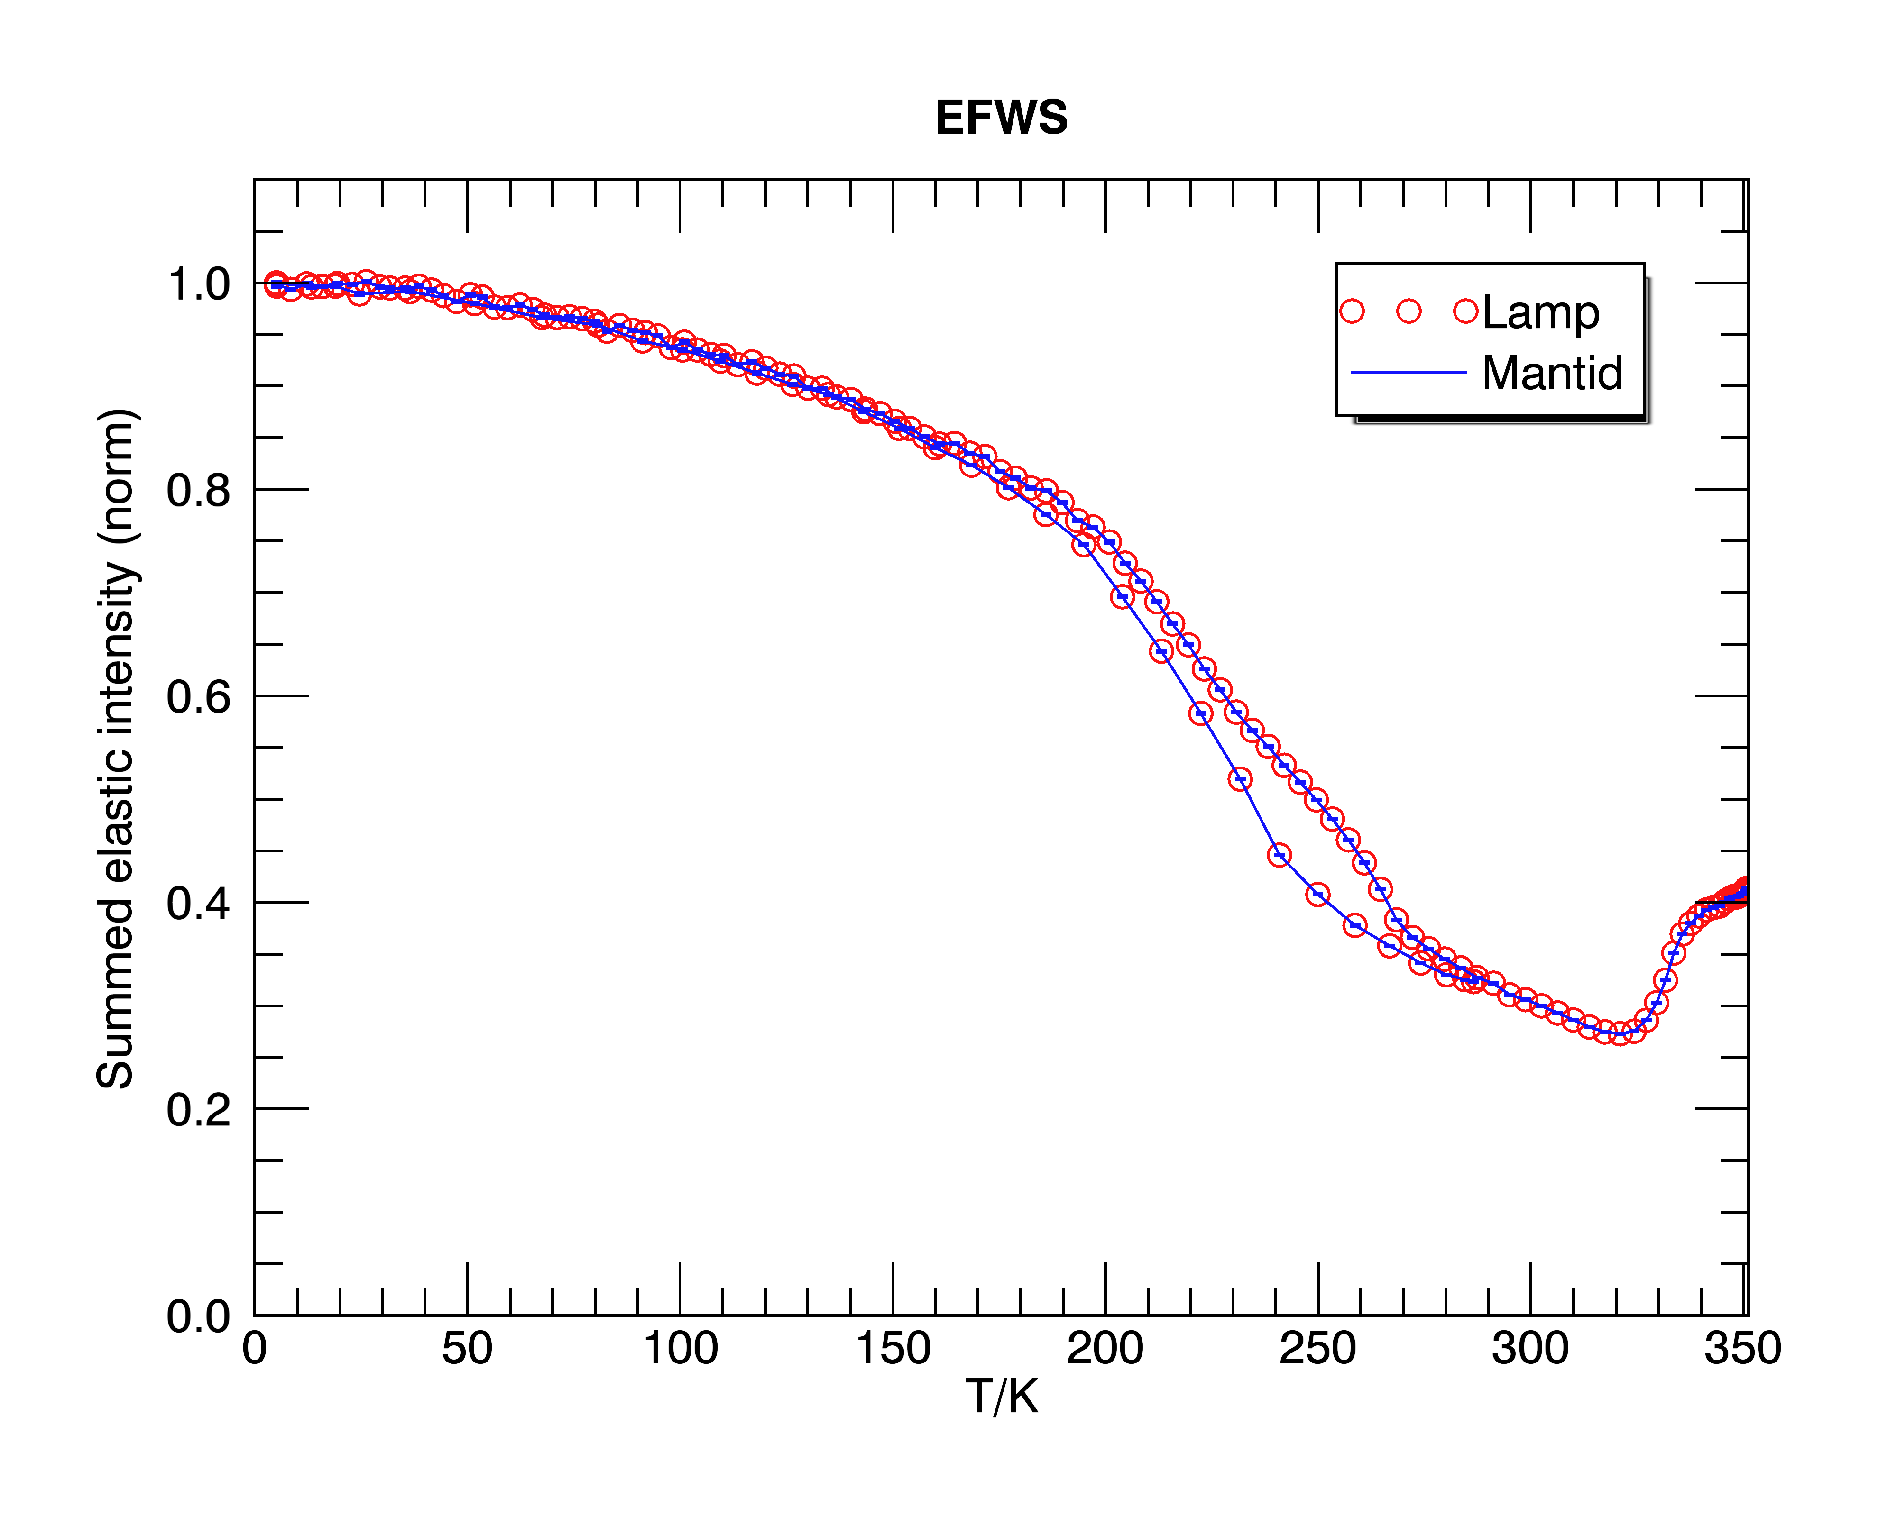
Status BS (IN16B)
Notes:
Highlight that elastic scans were not handled in June – this is completely new with all the options

Slide 13
Summary of progress since June
Details in https://github.com/mantidproject/documents/tree/ master/Project-Management/ILL/Weekly_Meetings
IN16b
Improve data loader – handling single and multi detectors
Multiple options needed for IN16B data – mirror modes, fixed window scans (elastic and inelastic)
Elastic peak alignment including when data has no elastic peak
GUI developments
Scope well defined by LAMP data treatment – little ‘creep’
Notes:
Say that this slide and the next two are based on notes from weekly meetings (see GitHub)
Multiple numors not handled previously in Mantid – not surprising at SNS (event mode data), more surprising at ISIS. * means valid for TOF and everywhere else in Mantid

Slide 14
Summary of progress since June
IN4/5/6
IDFs (Instrument Definition Files) revised
Monitor spectra and incident energy calibration
GUI: investigate DGS & MLZ approaches and algorithm runner and data processing
Further investigation of data corrections (beyond LAMP)
Absorption corrections, detector efficiency, vanadium DW, frame overlap, absolute units
Scope defined by LAMP and Bjorn’s requirements – some ‘creep’ in going beyond what is currently available
E.g.: Vanadium lattice dynamics, calculation of detector efficiencies
Multiple wavelengths (IN4)

Slide 15
Summary of initial progress since June
Generic
Handling multiple numors including metadata
Changes in NeXuS files
Dealing with exceptions and ‘bad’ cases
Unit and system tests
Documentation
Code reviewing for project (5-10% of time/effort)
Refining and polishing takes longer than creating basic framework – the devil is in the detail
“The first 90 percent of the code accounts for the first 90 percent of the development time. The remaining 10 percent of the code accounts for the other 90 percent of the development time” — Tom Cargill, Bell Labs

Slide 16
Instrument geometry
IN4:
IDF completed. Errors existing in 1st version (orientation of detectors, size) have been corrected and the last doubts about detectors’ geometry solved
IN6:
IDF completed. Detectors grouped in banks and monitor positions corrected. Also found that detector positions at 2θ > 102° were wrong by 0.8° (thanks to Bjorn who rediscovered a report by Ken Andersen from 1991, they have been incorrectly written between ~2000 and 2016).
IN16B:
Handle properly single detectors (use NeXuS file to determine used slots)
Handle data taken separately during Doppler acceleration and deceleration

Slide 17
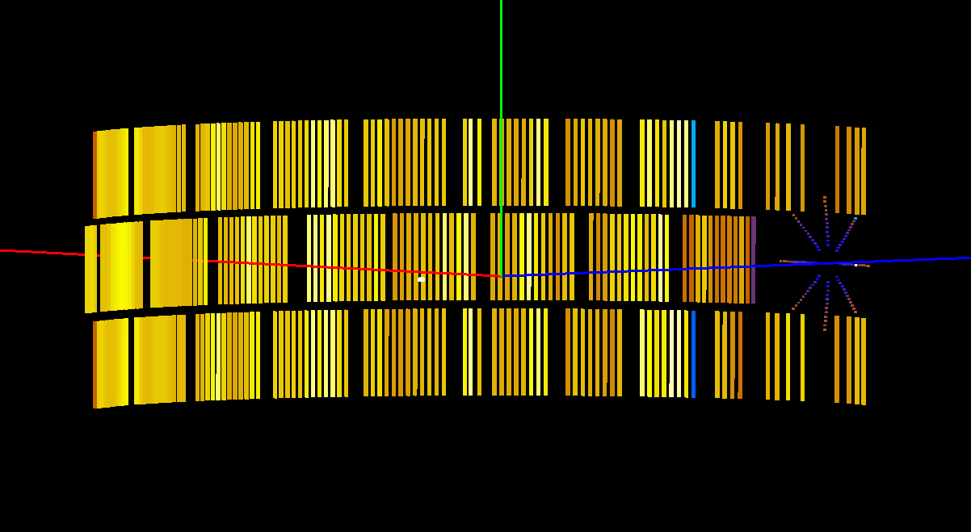
IN4: Initial IDF

Slide 18
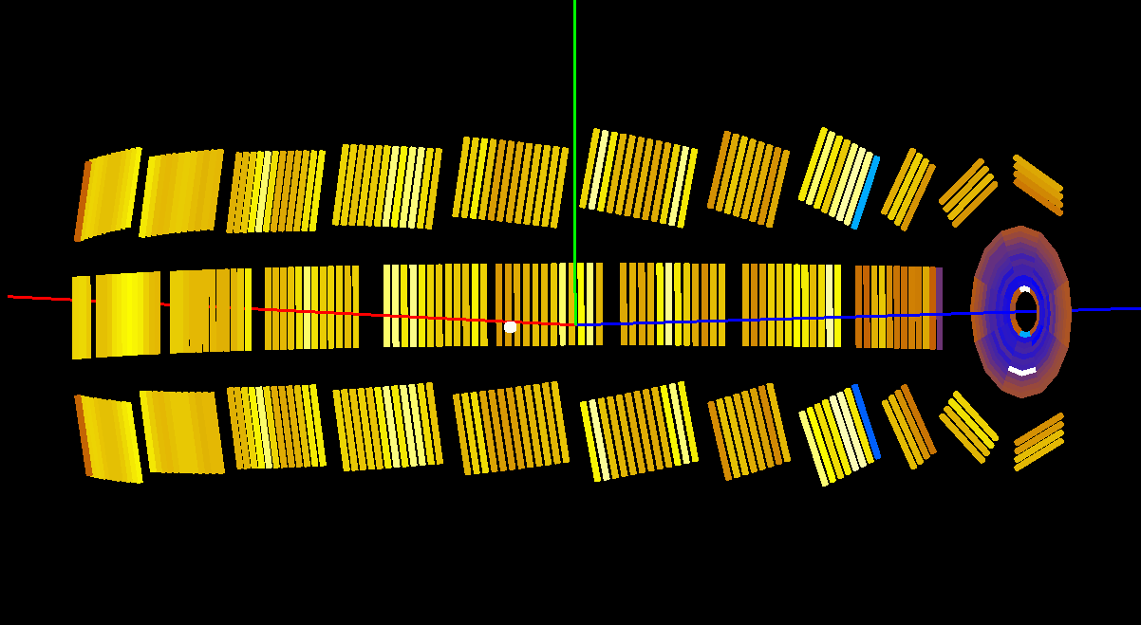
IN4: Present IDF

Slide 19
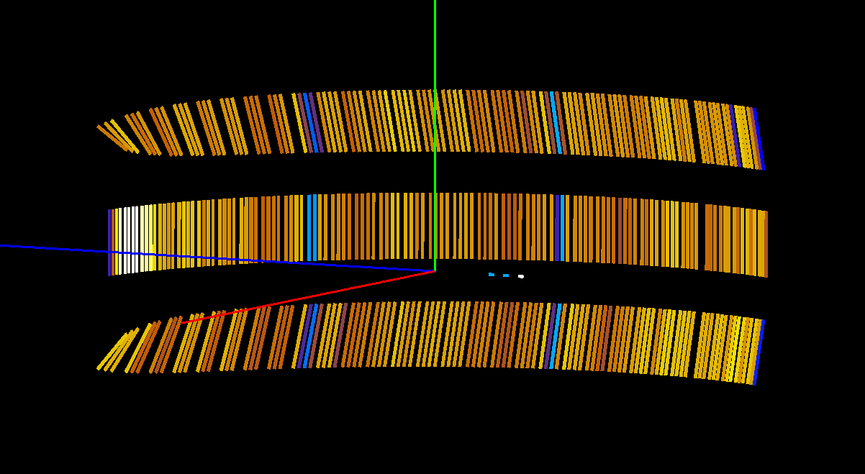
IN6: Initial IDF

Slide 20
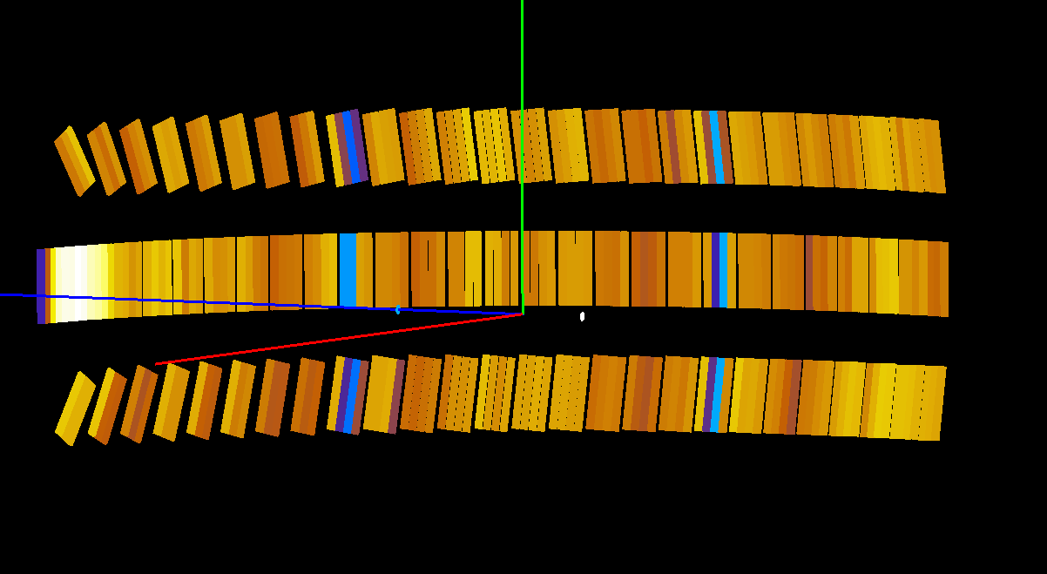
IN6: Present IDF

Slide 21
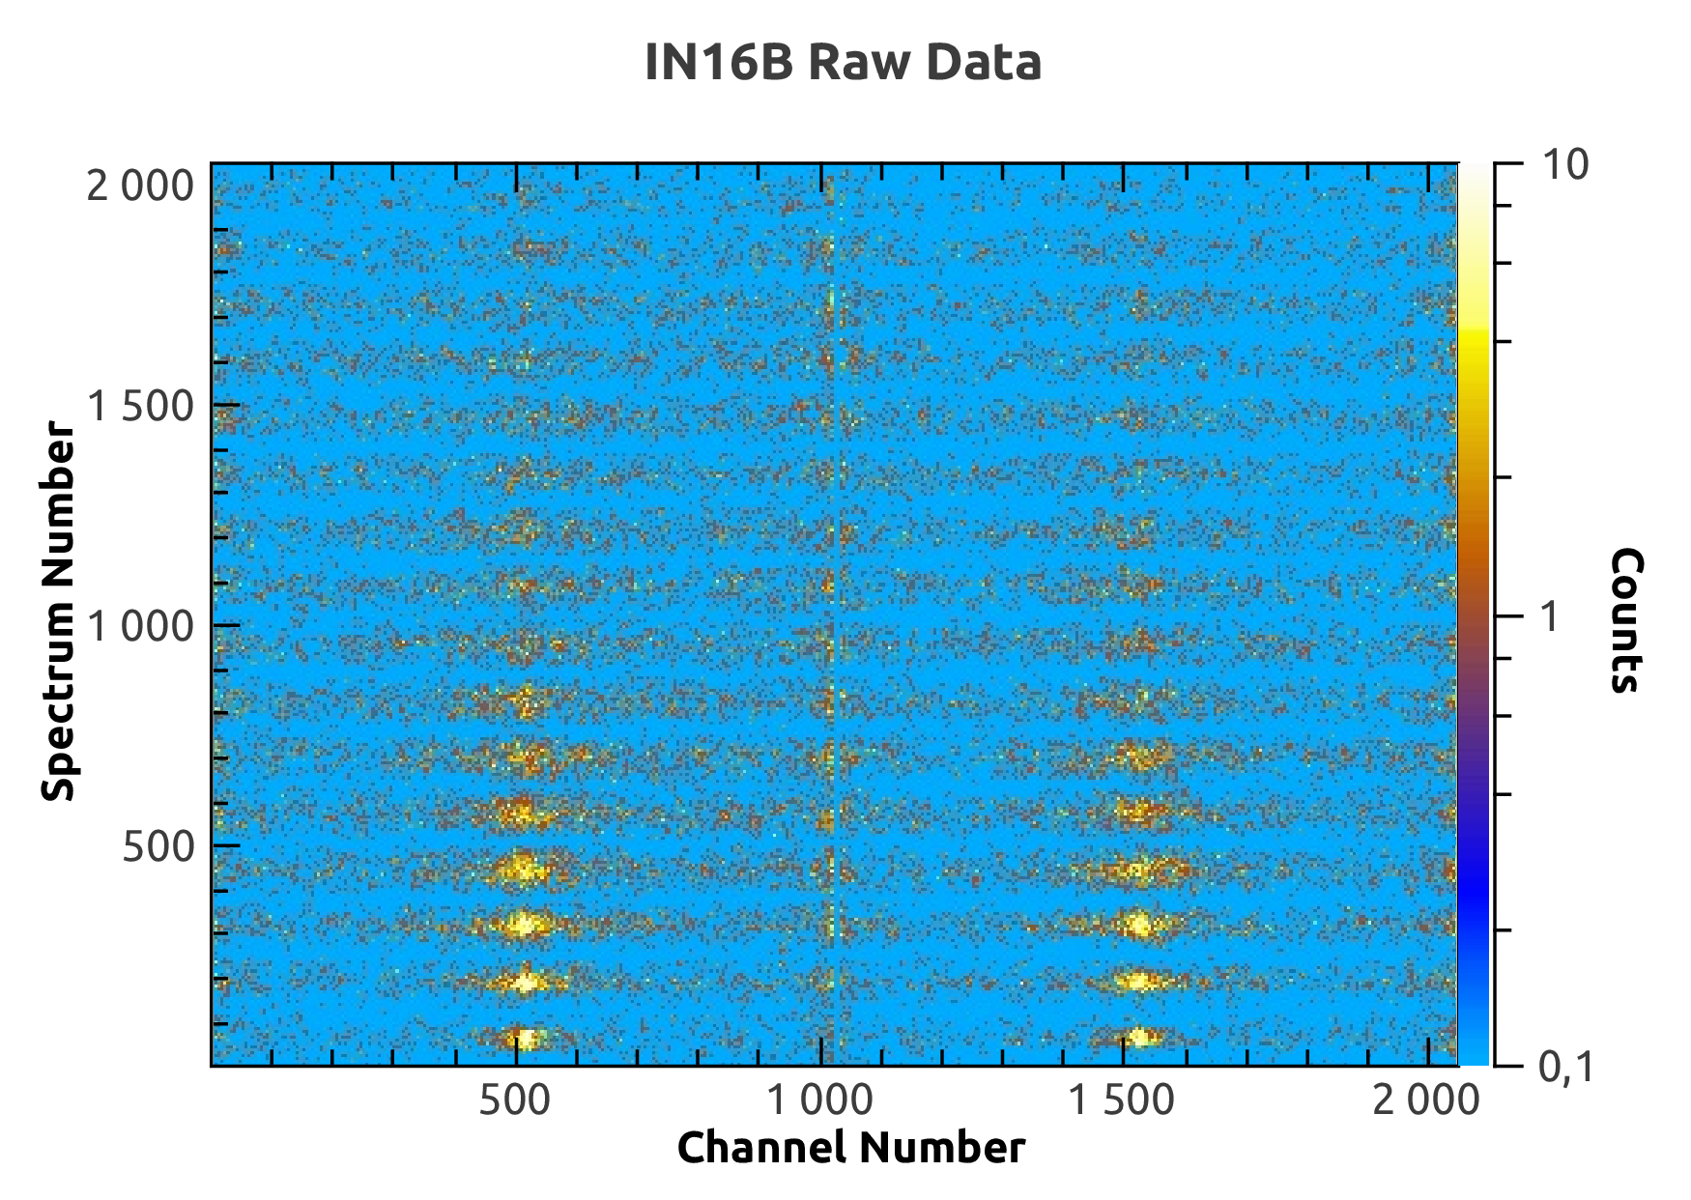
IN16B: Mirror sense

Slide 22
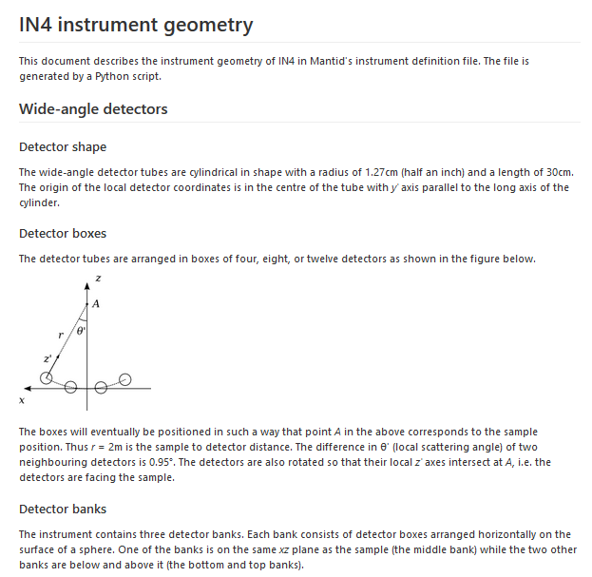
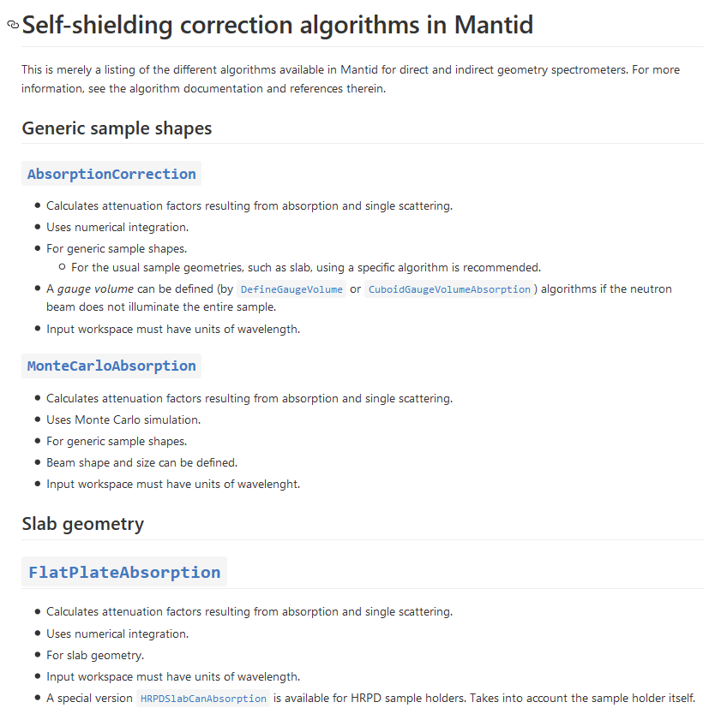
Documentation
https://github.com/mantidproject/documents/tree/master/Project-Management/ILL
Notes:
Working ILL documentation. Notes for us. Different from algorithm doc.

Slide 23
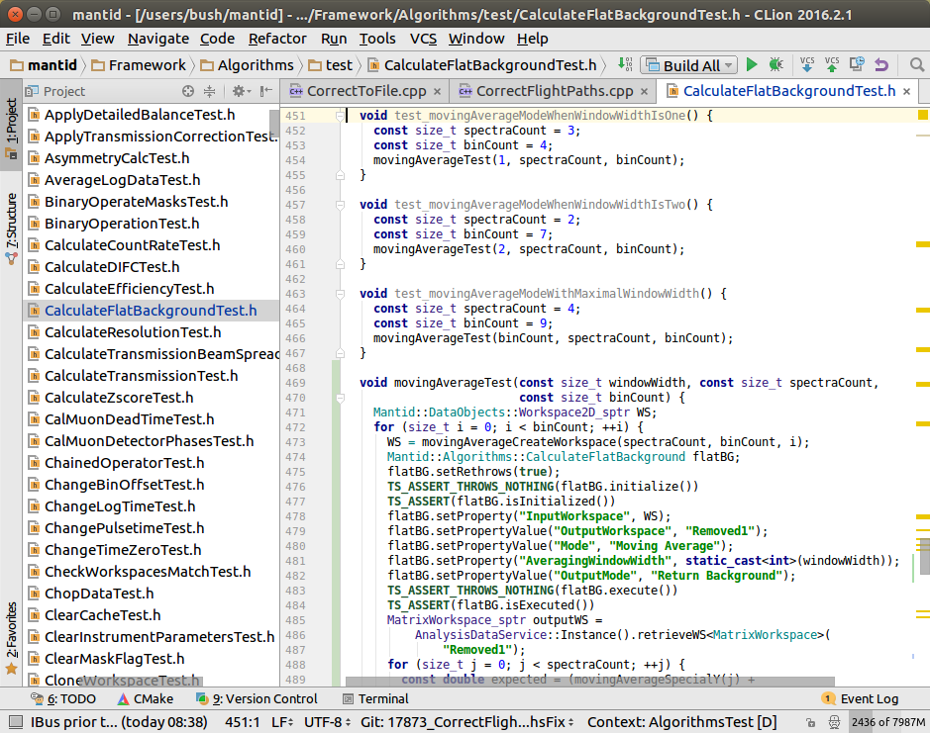
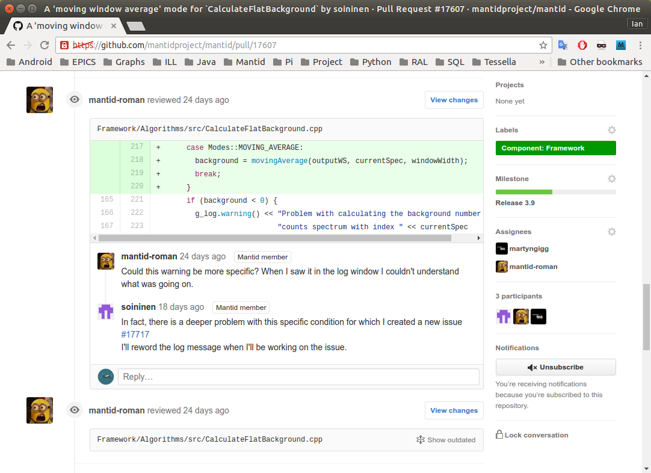
Tests and code revision

Slide 24
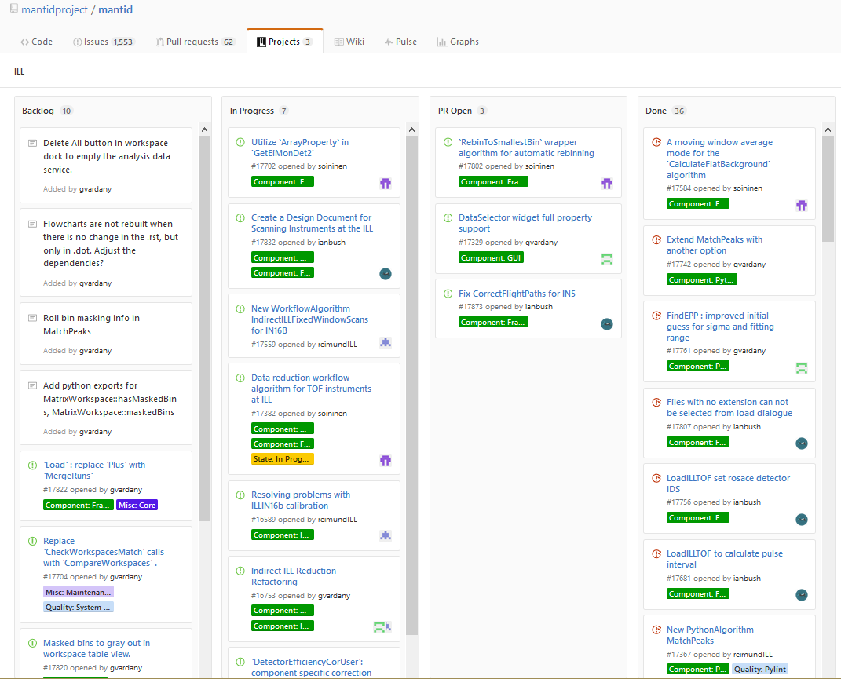
Algorithms developed or extended
https://github.com/mantidproject/mantid/projects/2
Created:
IndirectILLReduction
IndirectILLFixedWindowScans
SelectNexusFilesByMetadata
MatchPeaks
BinWidthAtX
MedianBinWidthAtX
GetEiMonDet v. 2
ExtractMonitorSpectra
WorkflowAlgorithmRunner
Modified:
MergeRuns
CalculateFlatBackground
ILLIN16BCalibration
CreateSampleWorkspace
DetectorEfficiencyCorUser
FindEPP
LoadILLIndirect
LoadILLTOF
…

Slide 25
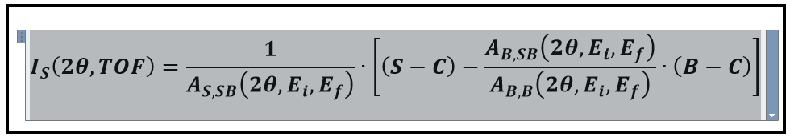
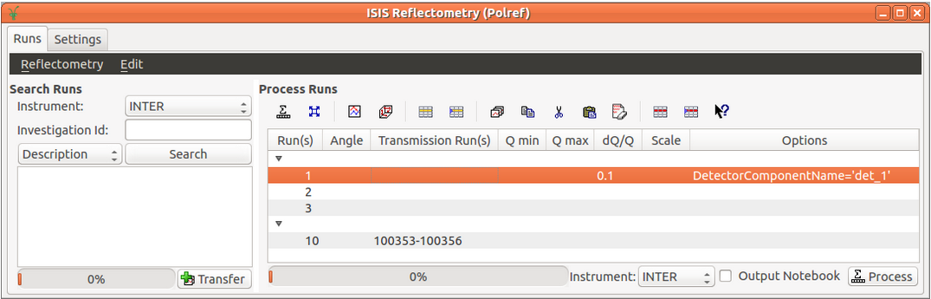
Planning
“Complete” current work for TOF & BS (Dec 2016)
Absorption corrections:
Accelerate algorithm
Implement in workflow
GUI + algorithm runner for TOF/BS
Design & discuss with BF and TS + related discussion to data process UI
Prototype and tests
First real tests in IN4 and IN16B
Feedback from B. Fak, T. Seydel and users
Correct/implement requests
Deploy in IN5 and IN6 this year
Maintenance
Notes:
Tentative date for this could be end of year?

Slide 26
Planning
New techniques – Proposition to discuss with IGLs
SANS (D11, D22, D33)
Decompose work in granular tasks
Loaders for D11 and D22 + revise D33 loader
Revise and evaluate existing algorithms and workflows
Implement one of the existing solutions (ideally) or design new one
Reflectometry (D17, Figaro)
Decompose work in granular tasks
Loader for Figaro + revise D17 loader
Only TOF option initially (i.e. Cosmos)
Check ISIS interface and adapt it or design a new one
SANS & REF: First tests and feedback during cycle 2017-2?
Powder diffraction (D20, D1B)
Notes:
Refine requirement given BS/TOF experience and give more realistic timeline

Slide 27
Planning
Other work:
Scanning instruments (IAN BUSH)
New design (discussions during NoBUGS Oct. 2016) based on Instrument 2.0 (refactor work to deal more efficiently with big instruments - ESS)
Prototype (D7, D4, D2B, D16)
BLOSC compression (not immediate)
Organization:
Daily stand-up meetings + frequent contacts with involved instrument scientists
Sprint meetings: one technique (person)/week & goals for 1 month
Project training:
Full team will follow a 2-days training for better management of scope & deliverables
NoBUGS Oct. 2016, Mantid workshop + MB meeting (May 2017)
Notes:
Scanning instruments and instrument 2.0 is a must for Ian

Slide 28
Thanks!
Questions?
Notes:
Scanning instruments and instrument 2.0 is a must for Ian

